Slide 1
Hadoop on HDInsight Overview
Ali Zaidi
Data Scientist
Machine Learning Education Team

Slide 2
Introduction
Class hours
9:30 A.M. to 4:30 P.M.
Restrooms
Meals
10:30 A.M. – 15 Min. Break
Noon – Lunch
3:00 P.M. – Break
Internet connectivity

Slide 3

Learning objectives
Reviewing Hadoop Fundamentals
Understanding Azure HDInsight
Provisioning with Azure HDInsight

Slide 4
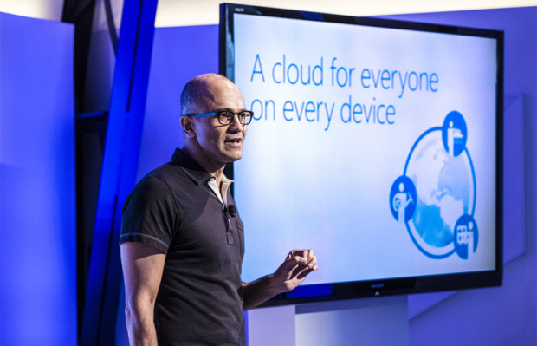












Slide 5
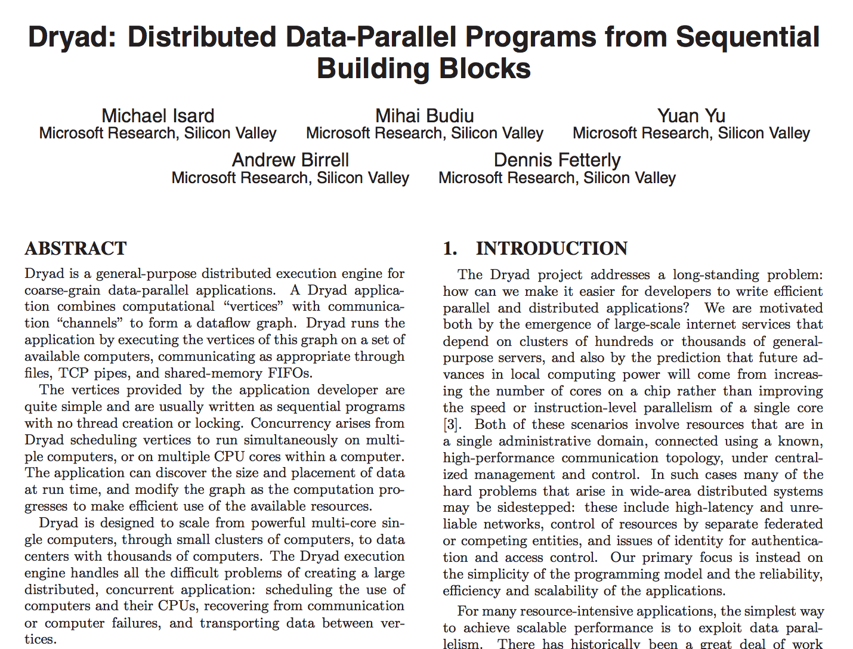
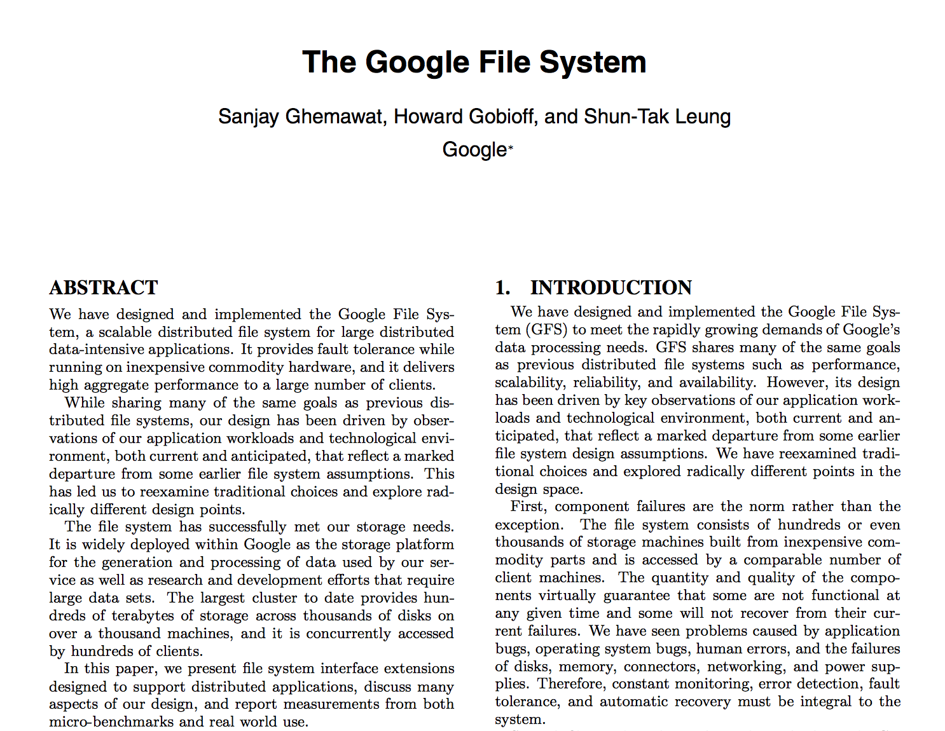
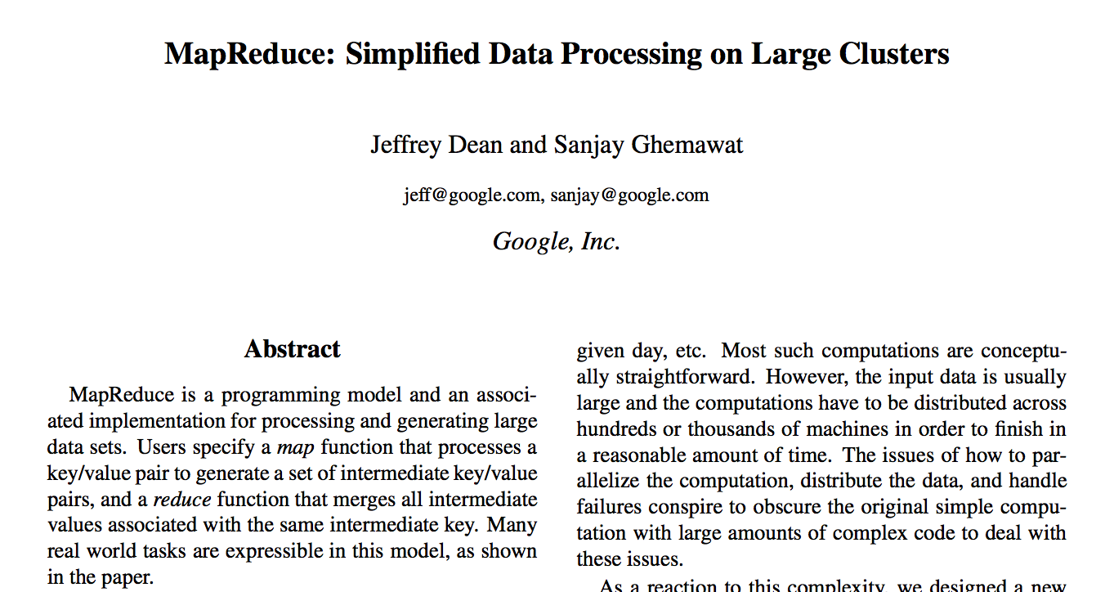
Distributed Storage and Computing
Proceedings of the 2007 Eurosys Conference
OSDI'04: Sixth Symposium on Operating System Design and Implementation, San Francisco, CA, December, 2004.
19th ACM Symposium on Operating Systems Principles, Lake George, NY, October, 2003.

Slide 6
HDInsight and the Hadoop Zoo Ecosystem
Visual Studio Tools
C#, F#, .NET
GraphX/GraphFrames
Spark SQL
Data Integration
(ODBC / SQOOP/ REST)
Core Hadoop
Pipeline / workflow
(Oozie)
Graph
(Pegasus)
Stats processing
(RHadoop)
Machine Learning
(Mahout)
Relational
(SQL Server)
MLLib/ Spark ML
Metadata
(HCatalog)
Azure SQL DW
Data Processing
Real Time Processing (Storm)
NoSQL Database
(HBase)
Scripting
(Pig)
Query
(Hive)
Azure Stream Analytics
Microsoft Integration
Distributed Processing
(MapReduce)
Event Pipeline
(Event Hub/ Flume)
Business Intelligence
(Excel, Power BI, SSAS)
Microsoft R Server (Enterprise R in the Cloud)
Data Movement
YARN
Distributed Storage (HDFS)
Cosmos DB
Azure Data Catalog
Azure Blob Storage and Azure Data Lake STore
Active Directory (Security)
ML Packages
Notes:
Full training example for the local HDP Instance: http://hortonworks.com/hadoop-tutorial/hello-world-an-introduction-to-hadoop-hcatalog-hive-and-pig/
More detail on the Hadoop Components: http://www.datasciencecentral.com/profiles/blogs/hadoop-herd-when-to-use-what
Hcatalog – exposes hive metadata to other applications, giving users a relational view of HDFS data
Hbase - A non-relational (NoSQL) database that runs on top of HDFS, random-realtime reads of HDFS data
Polybase - PolyBase is a technology that accesses and combines both non-relational and relational data, all from within SQL Server. It allows you to run queries on external data in Hadoop or Azure blob storage. The queries are optimized to push computation to Hadoop
https://msdn.microsoft.com/en-us/library/mt143171.aspx

Slide 7
Fundamentals of Hadoop on HDInsight

Slide 8
Positioning the various big data solutions
CONTROL
EASE OF USE
Specific apps in a multi-tenant form factor
Azure Data Lake Analytics
Workload optimized, managed clusters
User Adoption
Azure HDInsight
Any Hadoop technology
BIG DATA ANALYTICS
Azure Marketplace
HDP | CDH | MapR
IaaS Hadoop
Managed Hadoop
Big Data as-a-service
Azure Data Lake Analytics
Azure Data Lake Store
BIG DATA STORAGE
Azure Storage

Slide 9

“I can’t find a happy Hadoop customer. It’s sort of as simple as that,” says Bob Muglia, CEO of Snowflake Computing, which develops and runs a cloud-based relational data warehouse offering.

Slide 10
The Simplified Microsoft Big Data Stack
R Server
Azure Data Lake Analytics
MapReduce
Storm
HDInsight
Spark
Hive
Azure Data Lake Store

Slide 11
The Big Data Zoo
Hadoop Core
The goal of Hadoop is to create a unified framework for processing big data
Three major requirements:
Scalability
Reliability
Efficiency
MapReduce
Tez
YARN
HDFS
HDInsight simplifies the Hadoop ecosystem – easier to scale, guaranteed reliability with triple 9s SLAs, and optimized clusters for every workload.

Slide 12
Deprecation of HDInsight on Windows
HDI 3.3 is the last version of HDInsight on Windows
HDI 3.3 will be deprecated on July 31st 2017 *
Refer this to help migrate your customer to HDInsight on Linux
Impact: Post Deprecation (i.e. after July 31st 2017)
You will not be able to create a HDInsight cluster on Windows
You will not be able to resize an existing HDInsight on Windows cluster
* Deprecation time may vary by region.

Slide 13
Benefits of Azure HDInsight

Slide 14







HDInsight – What is it?
A standard Apache Hadoop distribution offered as a managed service on Microsoft Azure
Based on Hortonworks Data Platform (HDP)
Includes managed implementations of the Spark, HBase, Interactive Hive, Kafka, Storm, and more…
Optimized for scalability, efficiency and reliability in the cloud
Offers capacity-on-demand, pay-as-you-go pricing model
Integrates with:
Azure Blob Storage and Azure Data Lake Store for Hadoop File System (HDFS)
Azure Portal for management and administration
Visual Studio for application development tooling
Analytic and BI tools – R Server, PowerBI, etc.
In addition to the core, HDInsight supports the Hadoop ecosystem
Hive
Notes:
OBJECTIVE
This slide Introduces Microsoft HDInsight
TALKING POINTS
Azure HDInsight deploys and provisions managed Apache Hadoop clusters in the cloud, providing a software framework designed to process, analyze, and report on big data with high reliability and availability.
HDInsight uses the Hortonworks Data Platform (HDP) Hadoop distribution. Hadoop often refers to the entire Hadoop ecosystem of components, which includes Apache HBase, Apache Spark, and Apache Storm, as well as other technologies under the Hadoop umbrellas.
You can deploy these technologies on Windows or Linux cluster and can spin up the cluster in minutes. You can process semi-structured and unstructured data and develop in Java, .Net, Python, and more.
You can also visualize your data in Excel, Tableau, or Power BI. It integrates with the following:
Azure Blob Storage and Azure Data Lake Store for Hadoop File System (HDFS)
Azure Portal for management and administration
Visual Studio for application development tooling
RESOURCES
https://azure.microsoft.com/en-in/documentation/articles/hdinsight-hadoop-introduction/

Slide 15

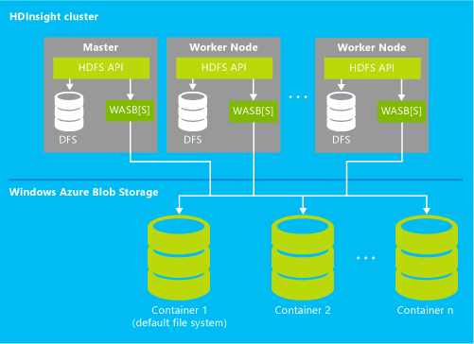
Benefits of Hadoop as an Azure service
HDInsight clusters can be configured in just a few minutes
Through the HDFS interface, HDInsight can operate directly on data stored in Azure Blob Storage or Azure Data Lake Store (without a separate, dedicated HDFS cluster)
Benefits include:
Data reliability, reuse and sharing
Elastic scale-out
Lower data storage costs
Protection against data loss
High performance: The high-speed flat networks in Azure datacenters provide fast access between virtual machines in the cluster and Azure Blob Storage or Azure Data Lake Store, so data movement is very efficient
Commission and decommission HDInsight clusters at will
Visualize data stored in Hive tables using Excel, PowerBI and add-ins: Power Query, Power View, PowerPivot, and Power Map
HDInsight cluster
Master
Worker node
Worker node
HFDS API
HFDS API
HFDS API
…
WebHDFS
WebHDFS
WebHDFS
DFS
DFS
DFS
Azure Data Lake storage
Container 1
Container 2
Container 3
Notes:
OBJECTIVE
This slide lists some benefits of Hadoop as an Azure service
TALKING POINTS
With HDInsight, deploy Hadoop in the cloud without buying new hardware or incurring other up-front costs. There is also no time-consuming installation or setup. Azure does it for you. Launch your first cluster in minutes.
Azure HDInsight provides a software framework designed to process, analyze, and report on big data with high reliability and availability (data reuse and sharing, elastic scale-out, lower data storage costs, and protection against data loss).
The high-speed flat networks in Azure datacenters provide fast access between the virtual machines in the cluster and Azure Blob Storage or Azure Data Lake Store, so data movement is very efficient.
HDInsight also integrates with BI tools such as Power BI, Excel, SQL Server Analysis Services, and SQL Server Reporting Services.
RESOURCES
https://azure.microsoft.com/en-in/services/hdinsight/

Slide 16



Azure HDInsight positioning
100% Apache Hadoop
Powered by the cloud
Immersive insights
Notes:
OBJECTIVE
This slide showcase Azure HDInsight positioning
TALKING POINTS
HDInsight is 100% Apache Hadoop-based service in the cloud. HDInsight is a Hadoop distribution powered by the cloud. This means HDInsight was architected to handle any amount of data, scaling from terabytes to petabytes on demand. You can spin up any number of nodes anytime. We charge only for the compute and storage you actually use.
You can get immersive insight using HDInsight with the familiar BI tools, such as Excel, PowerPivot, SQL Server Analysis Services, and SQL Server Reporting Services, to retrieve, analyze, and report data integrated with HDInsight by using either the Power Query add-in or the Microsoft Hive ODBC driver.
RESOURCES
https://azure.microsoft.com/en-in/documentation/articles/hdinsight-hadoop-introduction/

Slide 17


Microsoft + Hortonworks Promoting open Hadoop
Engineering alignment
Corporate alignment
Field alignment
Notes:
OBJECTIVE
This slide highlights how Microsoft and Hortonworks promote Open Hadoop
TALKING POINTS
Joint engineering teams: Joint people on each other’s teams. They report to Hortonworks and Hortonworks report to us. We share resources and have a joint engineering team. This is not just a re-licensing of a distro. We are one engineering team.
Milestone cadence: We do a 12-month calendar year roadmap with each other. That roadmap is what each company locks to, revisiting it every three months. When Cloudera released Impala, Microsoft and Hortonworks changed their resources to start working on the Stinger project. In CY13, this became a joint commitment to build Tez (vectorized query executor) and Stinger.
Joint planning and execution
Joint signoffs (Linux, Windows Azure): Microsoft and Hortonworks signed off on Linux, Windows, and Azure
Aligned offerings: HDP on Windows
HDI appliance, HDI service
Joint roadmap
CY planning/roadmap development
Quarterly adjustments
Hortonworks is making Hadoop an enterprise viable platform.
<look at partner page on Hortonworks site>
Engineering alignment
Microsoft worked with Hortonworks to develop Hortonworks Data Platform for Windows.
HDInsight on Windows Azure and HDInsight on PDW is based on HDP.
Microsoft and Hortonworks are working on various Hadoop sub-projects together (Stinger, Tez) contributed over 6K engineering hours, 25K+ lines of code
Corporate alignment
Microsoft is one of Hortonworks’ strategic partners (Q for Audrey)
Joint marketing alignment (webinars, events strategy, press, etc.)
Joint support alignment (Microsoft provides Lvl1 support and pays Hortonworks for Lvl2 and Lvl3)
Field alignment
Hortonworks field reps will get quota compensation or relief if HDP for Windows OR if PDW, Azure is sold
Microsoft field reps work with Hortonworks reps to get credibility from Hadoop story

Slide 18


HDInsight: Optimized for the Cloud
Customer choice
Managed and supported by Microsoft
Reuse of common tools, documentation, samples from Hadoop/Linux ecosystem
Open source analytics with industry-leading SLA
Enterprise-grade security and monitoring
Integration with analytics and BI tools
Notes:
OBJECTIVE
This slide briefly explains why HDInsight is the right customer choice for deployment on either Windows or Linux
TALKING POINTS
Select Linux or Windows clusters when deploying big data workloads into Microsoft Azure
With Windows, leverage existing Windows-based code, including .NET, to scale over all of your data in Azure
With Linux, customers can more easily move existing Hadoop workloads into the cloud and incorporate additional big data components to run in the service
By offering a choice for Windows and Linux clusters, Microsoft is enhancing flexibility for customers to create insight from the massive amounts of data being created in the cloud with the OS of their choice
RESOURCES
https://azure.microsoft.com/en-in/services/hdinsight/

Slide 19
HDInsight supports Hive
SQL-like queries on Hadoop data in HDInsight
HDInsight provides easy-to-use graphical query interface for Hive
HiveQL is a SQL-like language (a dialect of SQL)
Hive structures include well-understood database concepts such as tables, rows, columns, partitions
Compiled into MapReduce jobs that are executed on Hadoop
Dramatic performance gains with Stinger/Tez, Interactive Mode with Hive LLAP
Stinger is a Microsoft, Hortonworks, and OSS-driven initiative to bring interactive queries with Hive
Query execution engine technology from Microsoft SQL Server to Hive
Performance gains up to 100x
Hive LLAP for in-memory processing for providing real-time interactive data processing and 25x speed-ups
Sample Query
Microsoft contribution to Apache code
1400s
32x Speedup
44.3s
40X
Speedup
0.7s
100x
Speedup
35.1s
15s
Hive 10
HDP 1.3 / Hive 11
HDP 2.0
HDP 2.1
Hive LLAP
Hadoop 2.0
Notes:
OBJECTIVE
This slide briefly explains how you can use Apache Hive in Hadoop on HDInsight and choose how to run your Hive job
TALKING POINTS
Apache Hive is data warehouse software built on Hadoop that allows you to query and manage large data sets in distributed storage using a SQL-like language called HiveQL. Hive is an abstraction on top of MapReduce. When run, Hive translates queries into a series of MapReduce jobs.
You can also improve performance dramatically with Stinger/Apache Tez combined with Hive. Microsoft is starting to contribute to the Stinger initiative to dramatically speed up Hive and make it more enterprise-ready. Our main activity in Stinger right now is around Tez and vectorized query execution.
Tez is a framework that allows data-intensive applications such as Hive to run much more efficiently at scale. In the latest release of HDInsight, Hive supports running on Tez. Tez is enabled by default for Linux-based HDInsight clusters.
RESOURCES
https://azure.microsoft.com/en-in/documentation/articles/hdinsight-use-hive/

Slide 20

HDInsight supports HBase
NoSQL database on data in HDInsight
Columnar, NoSQL database
Runs on top of Hadoop Distributed File System (HDFS)
Provides flexibility for new columns to be added to column families at any time
HMaster
Coordination
Name node
Region server
Region server
Region server
Region server
JobTracker
Data node
Data node
Data node
Data node
TaskTracker
TaskTracker
TaskTracker
TaskTracker
Notes:
OBJECTIVE
This slide briefly explains how HDInsight supports Hbase
TALKING POINTS
Apache HBase is an open-source, NoSQL database that is built on Hadoop and modeled after Google BigTable. HBase provides random access and strong consistency for large amounts of unstructured and semi-structured data in a schemaless database organized by column families
HDInsight HBase is offered as a managed cluster that is integrated into the Azure environment. The clusters are configured to store data directly in Azure Blob Storage, which provides low latency and increased elasticity in performance and cost choices.
RESOURCES
https://azure.microsoft.com/en-in/documentation/articles/hdinsight-hbase-overview/

Slide 21

HDInsight supports Mahout
Machine learning library
A library of machine learning algorithms to execute on data in HDFS
Algorithms are not dependent on size of data and can scale with large data sets
Library includes: collaborative filtering, classification, clustering, dimensionality reduction, topic models
HDInsight supports Storm
Notes:
OBJECTIVE
This slide briefly explains how HDInsight supports Mahout
TALKING POINTS
Apache Mahout is a scalable library of machine learning algorithms that run on Hadoop. Using principles of statistics, machine learning applications teach systems to learn from data and use past outcomes to determine future behavior.
Mahout contains algorithms for processing data, such as filtering, classification, and clustering.
HDInsight supports also includes Apache Storm, an open source stream analytics platform that can process real-time events at large scale. This lets you process millions of events as they’re generated, enabling use cases like Internet of Things (IoT) and gaining insights from your connected devices or web-triggered events.

Slide 22



HDInsight supports Storm
Stream Analytics for near real-time processing
Consumes millions of real-time events from scalable event broker (i.e., Apache Kafka, Azure Event Hub)
Performs time-sensitive computation
Outputs to persistent stores, dashboards, or devices
Customizable with Java + .NET
Deeply integrated to Visual Studio
Event producers
Collection
Event queuing system
Transformation
Long-term storage
Presentation and action
Apache Storm on HDInsight
Kafka/
RabbitMQ/
ActiveMQ
HBase
Web/thick client dashboards
Applications
HDFS
Azure DBs
Event hubs
Azure Stream Analytics
Search and query
Cloud gateways (web APIs)
Stream processing
Devices
Azure Storage
Live Dashboards
Data analytics (Excel)
Sensors
Field gateways
Storage adapters
Devices to take action
Web and social
Notes:
OBJECTIVE
This slide briefly explains how HDInsight supports Storm
TALKING POINTS
Apache Storm on HDInsight allows you to create distributed, real-time analytics solutions in the Azure environment by using Apache Hadoop.
The Azure cloud makes Apache Storm easy and cost-effective to deploy, with no hardware to buy, no software to configure, your choice of development tools (Java or C#), and deep integration to Visual Studio.
It consumes millions of real-time events from a scalable event broker (i.e., Apache Kafka, Azure Event Hub). This brings near real-time analytics capabilities to HDInsight.
You can use the language of your choice: Provides support for Storm components written in Java, C#, and Python. Supports a mix of programming languages: Read data using Java, then process it using C#.
The image above describes an end-to-end applicability of HDInsight Storm.
RESOURCES
https://azure.microsoft.com/en-in/documentation/articles/hdinsight-storm-overview/

Slide 23


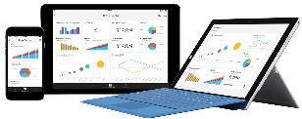




HDInsight supports Spark
In-memory processing on multiple workloads
Single execution model for multiple tasks (SQL Query, Spark Streaming, Machine Learning, and Graph)
Processing up to 100x faster performance
Developer friendly (Java, Python, Scala)
BI tool of choice (Power BI, Tableau, Qlik, SAP)
Notebook experience (Jupyter/iPython, Zeppelin)
Spark SQL
Spark Streaming
Machine Learning MLib
Graph GraphX
Notes:
OBJECTIVE
This slide briefly explains how HDInsight supports Spark
TALKING POINTS
Apache Spark is a parallel processing framework that supports in-memory processing to boost the performance of big-data analysis applications, Spark works for SQL, streaming data, and machine learning.
Spark delivers queries up to 100x faster than traditional big data queries. It provides a common execution model for tasks like ETL, batch queries, interactive queries, real-time streaming, machine learning, and graph processing on data stored in Azure Storage.
It make interactive queries over big data in Hadoop using BI tools or open source notebooks. You can create a streaming solution for IOT or a real-time application.
Use machine learning algorithms to be able to predict outcomes in your analysis with Notebook experience of Jupyter/iPython, Zeppelin.
REFERENCES
https://azure.microsoft.com/en-us/blog/interactive-analytics-on-big-data-with-the-release-of-spark-for-azure-hdinsight

Slide 24


Easy for data scientists with familiar R language
R Server for HDInsight
Largest portable R parallel analytics library
Terabyte-scale machine learning—1,000x larger than in open source R
Up to 100x faster performance using Spark and optimized vector/math libraries
Enterprise-grade security and support

Slide 25


HDInsight allows you to add Hadoop projects
Add Hadoop projects to HDInsight
Modify HDInsight clusters with custom script
Add Apache Hadoop projects to HDInsight
Documented for Spark, R, Giraph, Solr
…
Notes:
OBJECTIVE
This slide briefly explains how HDInsight allows you to add Hadoop projects
TALKING POINTS
You can customize Hadoop clusters to run other Hadoop projects.
This Hadoop ecosystem is a portfolio of fast-moving open source projects that are evolving quickly. To give customers flexibility, HDInsight has the option to deploy arbitrary Hadoop projects through custom scripts. This includes popular projects like Spark, R, Giraph, and Solr.

Slide 26
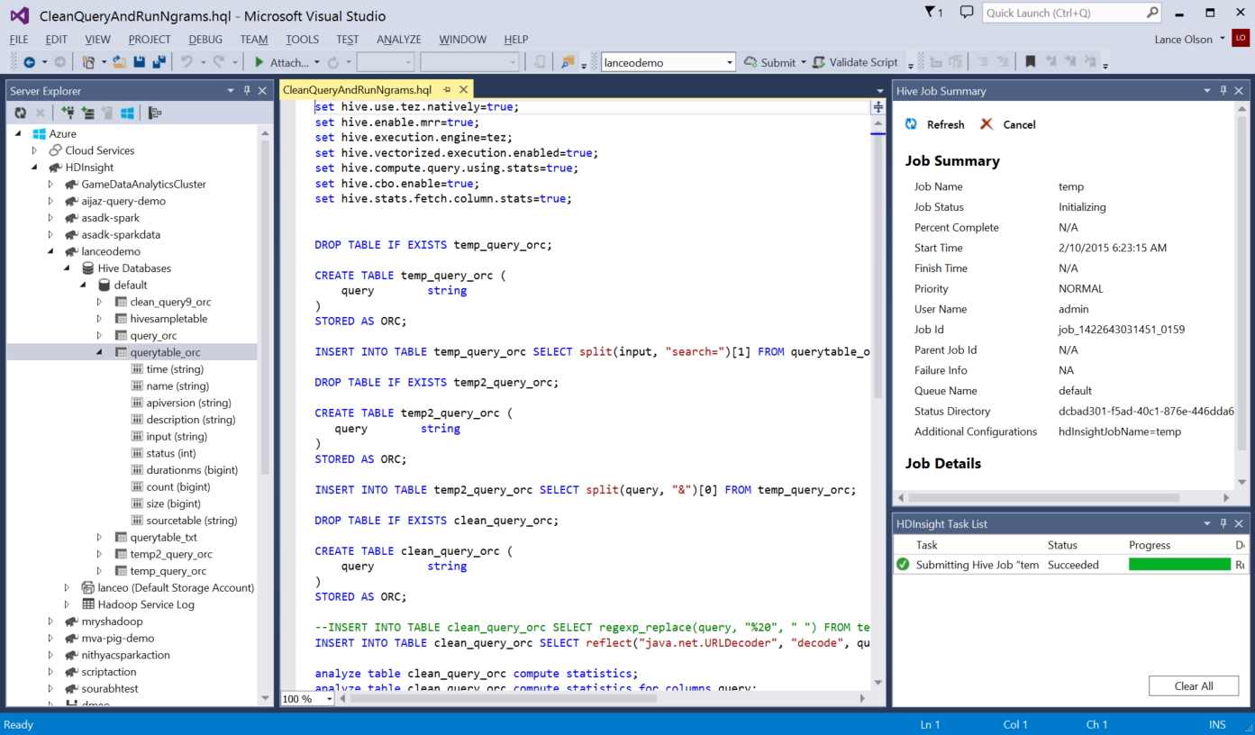
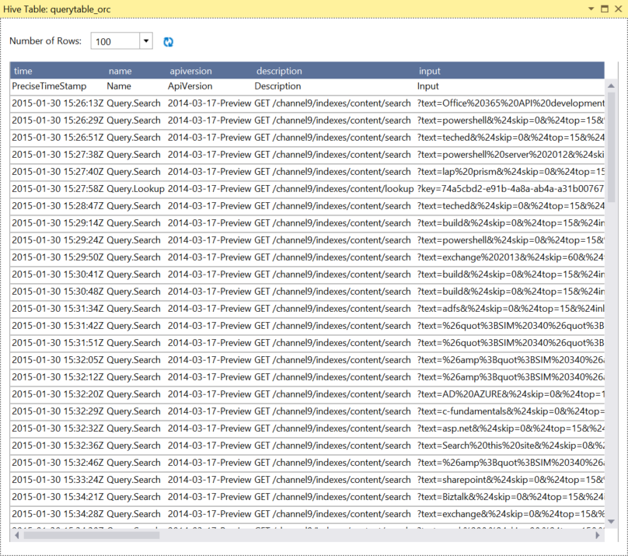
Microsoft makes Hadoop easier
Deep Visual Studio integration
Debug Hive jobs through Yarn logs or troubleshoot Storm topologies
Visualize Hadoop clusters, tables, and storage
Submit Hive queries, Storm topologies (C# or Java spouts/bolts)
IntelliSense
Notes:
OBJECTIVE
This slide briefly explains how to use Visual Studio with Hadoop
TALKING POINTS
Learn how to use HDInsight Tools for Visual Studio to connect to HDInsight clusters and submit Hive queries. It is time consuming to test Hive script against an HDInsight cluster, taking several minutes or more. HDInsight Tools for Visual Studio is capable of validating Hive script locally, without connecting to a live cluster.
HDInsight Tools for Visual Studio also enables users to see what’s inside the Hive job by collecting and surfacing the YARN logs of certain Hive jobs.
You can also use Visual Studio to visualize Hadoop clusters, tables, and storage.
Hive editor supports IntelliSense. HDInsight Tools for Visual Studio supports loading the remote metadata when you are editing your Hive script. For example, when you type "SELECT * FROM", the IntelliSense lists all the suggested table names. When a table name is specified, the column names are listed by the IntelliSense. The tool supports almost all Hive DML statements, subqueries, and the built-in UDFs.
RESOURCES
https://azure.microsoft.com/en-in/documentation/articles/hdinsight-hadoop-visual-studio-tools-get-started/

Slide 27
Introducing Azure HDInsight
100% Apache Hadoop
Powered by the cloud
Immersive insights
Notes:
TALKING POINTS
Azure HDInsight is an Apache Hadoop distribution powered by the cloud. This means that it handles any amount of data, scaling from terabytes to petabytes on demand. Spin up any number of nodes at any time. We charge only for the compute and storage you use.

Slide 28


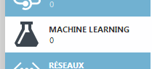










Why Microsoft Azure?
ML
Search
Data Factory
Event Hubs
Database
HDInsight
Stream Analytics
DocumentDB
Azure Storage
Azure facts
>4 trillion objects in Azure
300,000-1M+ requests per second
Double compute and storage every 6 months
On-premises Hadoop
Appliances
Software
Notes:
OBJECTIVE
This slide shows the growing momentum of Microsoft Azure
TALKING POINTS
Microsoft notes that more than half of the Fortune 500 are among the quarter of a million customers now using Azure.
Microsoft is boosting capacity at an even faster rate than customer growth, doubling its Azure compute and storage capacity every six to nine months along with expansions in Japan, Australia, and its 21 Vianet-operated Chinese Azure cloud.
In the past year, Microsoft has doubled its Azure customer base to 250,000 and averages around 1,000 new customers per day.
With over four trillion objects in Windows Azure and an average of 270,000 requests per second, customer requirements grow and are met daily. In peak periods, demand can grow to a staggering 880,000 requests per second.
Diagram shows: Azure easily integrates with your existing IT environment through the largest network of secure private connections, hybrid database and storage solutions, and data residency and encryption features—so your assets stay right where you need them. And with Azure Stack, you can bring the Azure model of application development and deployment to your datacenter. Azure hybrid cloud solutions give you the best of both worlds: more IT options, less complexity and cost. This is why it is one of the best cloud computing services available.
RESOURCES
http://www.zdnet.com/article/microsoft-claims-azure-now-used-by-half-of-the-fortune-500/

Slide 29



No hardware challenges
HDInsight in the cloud bypasses hardware costs
Hardware acquisition
Hardware maintenance
Performance tuning
HDInsight in the cloud bypasses capacity planning
Spin up any number of Hadoop nodes on demand
Go from tens to thousands of nodes
No HW costs
Unlimited scale
$0
Notes:
OBJECTIVE
The slide highlights how you can skip hardware purchase and maintenance with Azure HDInsight
TALKING POINTS
With HDInsight, you can deploy Hadoop in the cloud without buying new hardware or other up-front costs. There’s also no time-consuming installation or setup. Azure does it for you. You can launch your first cluster in minutes.
HDInsight in the cloud bypasses capacity planning. It handles any amount of data, scaling from terabytes to petabytes on demand. Spin up any number of nodes at any time. We charge only for the compute and storage that you use.

Slide 30

Mission-critical, enterprise-ready
Managed Hadoop, backed by SLA
Three nines of availability: 99.9% uptime
HDInsight auto-replicates data
Automatic geo-replication of data
Data only replicates within same geo-political (i.e., country, region)
Mission-critical Hadoop
Notes:
OBJECTIVE
The slide highlights how Azure is mission-critical and enterprise-ready
TALKING POINTS
Automatic provisioning of Hadoop clusters. HDInsight clusters are much easier to create than manually configuring Hadoop clusters.
This is managed Hadoop, backed by an SLA. You can get Three Nines of Availability and 99.9% uptime
High availability and reliability of clusters. A second head node has been added to the Hadoop clusters deployed by HDInsight to increase the availability of the service. Standard implementations of Hadoop clusters typically have a single head node. HDInsight removes this single point of failure with the addition of a secondary head node. The switch to a new HA cluster configuration doesn't change the price of the cluster, unless customers create clusters with an extra-large head node instead of the default large-size node.

Slide 31
Maintenance done for you
Minimal IT resources for upgrades/patching
OS patching and security updates done automatically
Minimal IT resources to update Hadoop versions
Hadoop versions are rapidly releasing throughout year
Always be on latest version of Hadoop, without effort
Notes:
OBJECTIVE
This slide shows how Azure handles all maintenance tasks in HDInsight, so that you can focus on your strategic work
TALKING POINTS
OS patching and security updates are performed automatically by Azure, requiring minimal IT resources for upgrades/patching.
Hadoop versions are rapidly releasing throughout the year, so you are always on the latest version of Hadoop without effort. This helps minimize IT resources to update Hadoop versions.

Slide 32
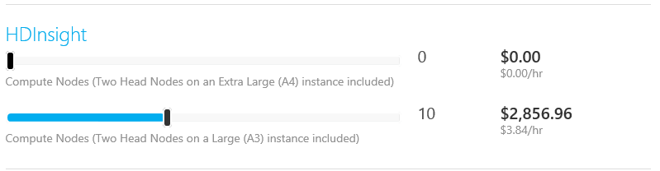
Low cost
HDInsight is billed by usage
Billed for usage
Clusters can be deleted when no longer used
No additional price for support
Azure Support includes Hadoop support
What usually costs thousands of dollars per node is included
$£€¥
Notes:
OBJECTIVE
The slide highlights how Azure is a low-cost solution for an organization
TALKING POINTS
Open source does not mean free. Deploying Hadoop on-premises still requires servers and skilled Hadoop experts to set up, tune, and maintain them. A cloud service lets you spin up a Hadoop cluster in minutes without up-front costs.
In the Microsoft Azure cloud, HDInsight is billed by usage: you pay only for the compute and storage you use, when you use it. Spin up a Hadoop cluster, analyze your data, and then shut it down to stop the meter. Clusters can be deleted when no longer used.
Create a Hadoop cluster in minutes, and add nodes on demand. The cloud offers organizations immediate time to value.

Slide 33
Introducing Azure HDInsight
100% Apache Hadoop
Powered by the cloud
Immersive insights

Slide 34
Bringing Hadoop to 1 billion people
Excel as the BI tool for everyone
Power BI for collaboration & new experiences
1 billion Microsoft Office users
Connect to HDInsight
Analyze
Visualize
Fastest-growing commercial product ever
Share
Ask
Access
Scalable, manageable, trusted
Notes:
OBJECTIVE
This slide highlights how Azure is bringing Hadoop to 1 billion people using Excel and Power BI
TALKING POINTS
Azure HDInsight combines the best of Hadoop open source technology with the security, elasticity, and manageability that enterprises require. We have built it to integrate with Excel and Power BI―our business intelligence offering―allowing people to easily connect to data through HDInsight, and then refine and do business analytics in a turnkey fashion.
Excel is the BI tool for everyone. Already 1 billion Microsoft Office users can connect to HDInsight to analyze and visualize data. Power BI helps with collaboration and new experiences for Share, Ask, and Access data.

Slide 35

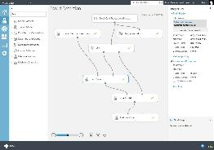
Making advanced analytics accessible to Hadoop Microsoft Azure Machine Learning
ML Studio
ML API service
Easily make changes
HDInsight
SQL Server VM
Cloud
Workspace
SQL DB
Blobs & tables
Microsoft Azure Portal
Publish API
Publish API in minutes
Desktop
Devices
Applications
Dashboards
Web
Historical data
Test model types
Run & refine
Results
Notes:
OBJECTIVE
The slide shows how you can build complete machine learning solutions in the cloud using Microsoft Azure Machine Learning
TALKING POINTS
Azure Machine Learning not only provides tools to model predictive analytics, but also provides a fully managed service you can use to deploy your predictive models as ready-to-consume web services. Azure Machine Learning provides tools for creating complete predictive analytics solutions in the cloud: Quickly create, test, operationalize, and manage predictive models. You do not need to buy any hardware nor manually manage virtual machines.
Azure Machine Learning has everything you need to create predictive analytics solutions in the cloud from a large algorithm library, to a studio for building models, to an easy way to deploy your model as a web service.

Slide 36
Compute Workloads on YARN
MapReduce & Tez
Spark
Data Lake Analytics
YARN
WebHDFS
Data Lake Store
Notes:
This 3 years out

Slide 37
Workload Variants
CPU Intensive
Memory Intensive
I/O Intensive
Characteristics
Heavy computations
Examples
Machine Learning
Natural Language Processing
Characteristics
High memory usage
Examples
PageRank
Real-time analytics
Characteristics
Heavy Read/Write
Examples
Copy
Data preparation

Slide 38
Usage of Throughput
Compute
Utilized Throughput
Available Throughput
Storage

Slide 39
Consume Available Throughput
Compute
Utilized Throughput
Available Throughput
Storage

Slide 40
ADLS Provides Massive Throughput
HDInsight
Utilized Throughput
No fixed throughput limit
ADLS

Slide 41
Anatomy of an HDInsight Cluster
HDInsight
Application Layer
Tasks
Memory
Cores
YARN Layer
# of containers
Container size
A-series
D-series
F-series
Memory
Cores
Network
Physical Layer
# of VMs
VM Type
VM Size

Slide 42
Anatomy of an HDInsight Cluster
HDInsight
Application Layer
Tasks
Memory
Cores
YARN Layer
# of containers
Container size
A-series
D-series
F-series
Memory
Cores
Network
Physical Layer
# of VMs
VM Type
VM Size

Slide 43
Physical Level
Increase # of VMs

Slide 44
Physical Level
Use VMs with more memory

Slide 45
Physical Level
Use VMs with more network bandwidth
Moderate
Extremely high

Slide 46
Anatomy of an HDInsight Cluster
HDI
Application Layer
Tasks
Memory
Cores
YARN Layer
# of containers
Container size
A-series
D-series
F-series
Memory
Cores
Network
Physical Layer
# of VMs
VM Type
VM Size

Slide 47
YARN Level
Use smaller YARN containers

Slide 48

YARN Level
Increase cores per container

Slide 49
Anatomy of an HDInsight Cluster
HDI
Application Layer
Tasks
Memory
Cores
YARN Layer
# of containers
Container size
A-series
D-series
F-series
Memory
Cores
Network
Physical Layer
# of VMs
VM Type
VM Size

Slide 50
Workload Level
Use all available containers

Slide 51

© 2016 Microsoft Corporation. All rights reserved. Microsoft, Windows, Windows Vista, and other product names are or may be registered trademarks and/or trademarks in the U.S. and/or other countries.
The information herein is for informational purposes only and represents the current view of Microsoft Corporation as of the date of this presentation. Because Microsoft must respond to changing market conditions, it should not be interpreted to be a commitment on the part of Microsoft, and Microsoft cannot guarantee the accuracy of any information provided after the date of this presentation. MICROSOFT MAKES NO WARRANTIES, EXPRESS, IMPLIED OR STATUTORY, AS TO THE INFORMATION IN THIS PRESENTATION.

